Slide 1
Group 2
CS 584 Machine Learning Spring 2023
Music Therapy Treatment based on Emotion Detection
Elisha Maria K Orlina (A20520119)
Raj Shah
(A20524266)
Abhishek Jaiswal
(A20380004)

Slide 2
Introduction
Facial expressions are critical for dynamic user interactions in various fields such as security, entertainment, and human-machine interaction. With the ability to detect and interpret subtle changes in facial expressions, computer vision systems can improve accuracy in understanding human emotions. Furthermore music has been an integral part of human experience for ages and is a powerful tool for improving emotional and psychological well-being. Research has shown that music can boost mood, reduce anxiety and even serve as a therapeutic tool. As technology continues to advance, accurately detecting and interpreting facial expressions and using music as a therapeutic tool will become even more critical.
This project proposes a system that uses convolutional neural networks to detect a person's mood through facial emotion recognition and generates a music playlist based on the detected mood. Unlike humans, machines find detecting facial expressions challenging, but advancements in technology have made convolutional neural networks (CNNs) an efficient solution for this task. To train the model, the FER Dataset will be used, which contains grayscale facial images that are 48 pixels in height and width. This system has the potential to accurately recognize facial expressions and improve the user experience in various fields, including entertainment and healthcare.

Slide 3
Problem Description
We are trying to solve the problems mentioned below-
Helping people to overcome mental stress, anxiety, and acute depression, including other mood fluctuations like- gloom, worry, and fear (untouched yet). Thus it will be more like a music therapy system rather than a mere music recommendation system.
We are also focussing on people who drive unaccompanied and are going through mental issues. Our model will detect the mood and play as a positive distraction, maybe by lifting the mood.

Slide 4
Proposed System (Milestones)
Task Achieved:
Data Collection- We have collected adequate data through open-source datasets available on the Kaggle, & UCI ML repo.
Exploratory Data Analysis (EDA) - To get insights from the data we have done EDA after data preprocessing.
Task in Progress:
Data Augmentation - To adjust inefficiency of data.
Model Training - To improve the overall model accuracy.
Hyperparameter Tuning - After getting the data and performing resizing and re scaling we will separate the data into training, testing, and validation sets. Thereafter we will be using the Keras to train the model.
Documentation - This is an ongoing process that is related to other tasks.
Asana Access.

Slide 5
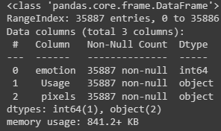

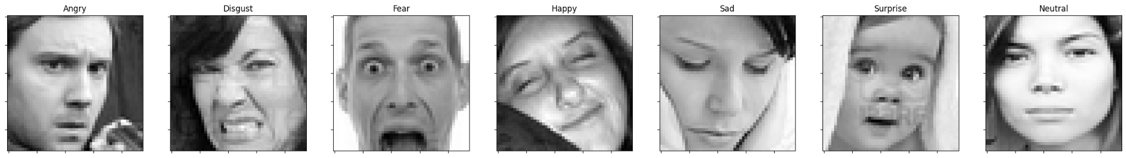
Data Description
The model will be trained on the FER Dataset, which contains grayscale facial images that are 48 pixels in height and width.
The training set comprises 28,709 examples, and the public test set comprises 3,589 examples.
The private test set consists of 3589 examples.
We have seven emotions namely- Angry, Disgust, Fear, Happy, Sad, Surprise, and Neutral

Slide 6
Data Preparation & Analysis
We first take a dataframe of image data, and then extracts the pixel values and corresponding labels, and make two arrays: one containing the pixel values of the images and the other containing their corresponding labels.
We then create a dictionary that maps integer labels to their corresponding emotion names. The keys in the dictionary are integers ranging from 0 to 6, which correspond to the seven emotions in the dataset. The values are the names of the corresponding emotions.
We then use the public training set as our training set to the machine learning model, private testing set as the validation set and public testing set as the testing set.
Then we reshape the image array to have a shape of (number of images, 48, 48, 1). The last dimension of 1 is added to represent that each image has a single color channel (grayscale). This is necessary because the convolutional layers in a CNN model expect inputs in this shape.
Then we normalize the pixel values.
Next step is to convert the label arrays from integer format to one-hot encoded format using the to_categorical() function.

Slide 7
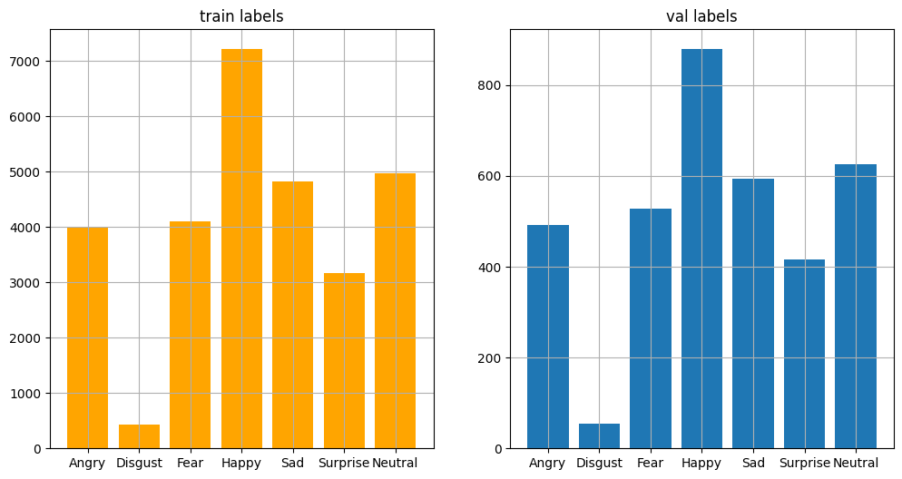
Data Preparation & Analysis
7. We then visualize the distribution of the training labels and validation labels and compare them. This can be useful to identify any class imbalance issues that may affect the performance of the machine learning model.

Slide 8
Proposed System (Milestones)
Task to do:
Batch Normalization - It is the technique of adding extra layers to a deep neural network to make it faster and more stable. In this, first, the input will be normalized, and later re scaling and offsetting will be performed.
Getting the best model parameters - We will try different models to check which model works better for us and then we’ll move ahead with that as per the accuracy results.
Visualization - In this phase, we will try to visualize some of the outcomes.
Documentation - This is an ongoing process that is related to other tasks in this section.

Slide 9

Future works

Slide 10
Model training
Algorithm which we will implement for model training is CNN.
CNN (Convoluted Neural Networks) -
We are going to augment the dataset by applying transformations such as rotations, scaling, and flipping to create new images. This increases the diversity of the dataset and helps prevent overfitting.
We will choose a CNN architecture that is appropriate for the face recognition task. A common approach is to use a combination of convolutional layers, pooling layers, and fully connected layers to extract features from the input images and classify them.
We will Train the CNN model on the preprocessed and augmented dataset using techniques such as backpropagation and stochastic gradient descent to optimize the model parameters. Evaluate the performance of the trained model on a separate validation set to determine its accuracy and identify any areas for improvement.
Once the model has been trained and validated, it can be deployed in the system to identify people’s face emotions accurately.
The goal of model training is to enable the model to make accurate predictions on new data that it has not seen before. The process of model training involves iteratively adjusting the model's parameters in order to minimize a loss function, which measures the difference between the model's predictions and the true values in the training data. The choice of loss function depends on the type of problem being solved and the type of algorithm being used.

Slide 11
Why CNN over other algorithms?
CNNs can effectively learn and extract features from images by using convolutional layers, which perform operations such as edge detection and feature extraction on the input images. This allows the network to learn and recognize patterns in images that are relevant to the task at hand, such as specific facial expressions or emotions.
CNNs are specifically designed for image processing tasks, which makes them an excellent choice for emotion detection tasks that involve analyzing facial expressions from images.
Additionally, CNNs have achieved state-of-the-art performance in various computer vision tasks, including facial expression recognition, making them a popular choice for this type of application.
In comparison to other algorithms, such as decision trees or logistic regression, CNNs have the ability to learn complex non-linear relationships between input features, making them ideal for tasks like emotion detection, which involve analyzing complex, high-dimensional data.

Slide 12
References
S Metilda Florence and M Uma 2020 IOP Conf. Ser.: Mater. Sci. Eng. 912 062007
Ramya Ramanathan, Radha Kumaran, Ram Rohan R, Rajat Gupta, and Vishalakshi Prabhu, an intelligent music player based on emotion recognition, 2nd IEEE International Conference on Computational Systems and Information Technology for Sustainable Solutions 2017. https://doi.org/10.1109/CSITSS.2017.8447743
Roberto De Prisco , Alfonso Guarino , Delfi fi na Malandrino and Rocco Zaccagnino. Induced emotion-based music recommendation through reinforcement learning. Appl. Sci. 2022, 12, 11209
Zhuwei Qin, Fuxun Yu, Chenchen Liu, Xiang Chen. How convolutional neural networks see the world - A survey of convolutional neural network visualization methods. Mathematical Foundations of Computing, May 2018.
Frans Norden and Filip von Reis Marlevi, A Comparative Analysis of Machine Learning Algorithms in Binary Facial Expression Recognition, TRITA-EECS-EX-2019:143
Research Prediction Competition, Challenges in representation learning: facial expression recognition challenges, Learn facial expression from an image, (KAGGLE)

Slide 13
Thank you,
Please feel free to ask any questions.

